Slide 1
Restoration Advisory Board Meeting
September 13, 2017

Slide 2
Agenda
Review/Accept May 17th Meeting Minutes
Remedial Investigation Report Update
Aquifer Pilot Test Update
Rivercrest Soil Gas Sampling
Feasibility Study
Upcoming Work
Schedule Next Meeting
Adjourn

Slide 3
Remedial Investigation Report
Internal Army Review Complete
RAB Comments will be incorporated
NHDES Comments Received
Will be issued for 45-day public review and comment once NHDES Comments Addressed.

Slide 4
Constant Rate Pumping Test
Water Treatment Plant Optimization
Evaluate capture zone for design of smaller treatment system
Two interception wells installed
15 wells outfitted with water level transducers
Pumping ran Aug. 8 to Sept 6 (29 Days)
Wells pumped at 25 gpm and 30 gpm
Monitor water level rebound up to September 11

Slide 5
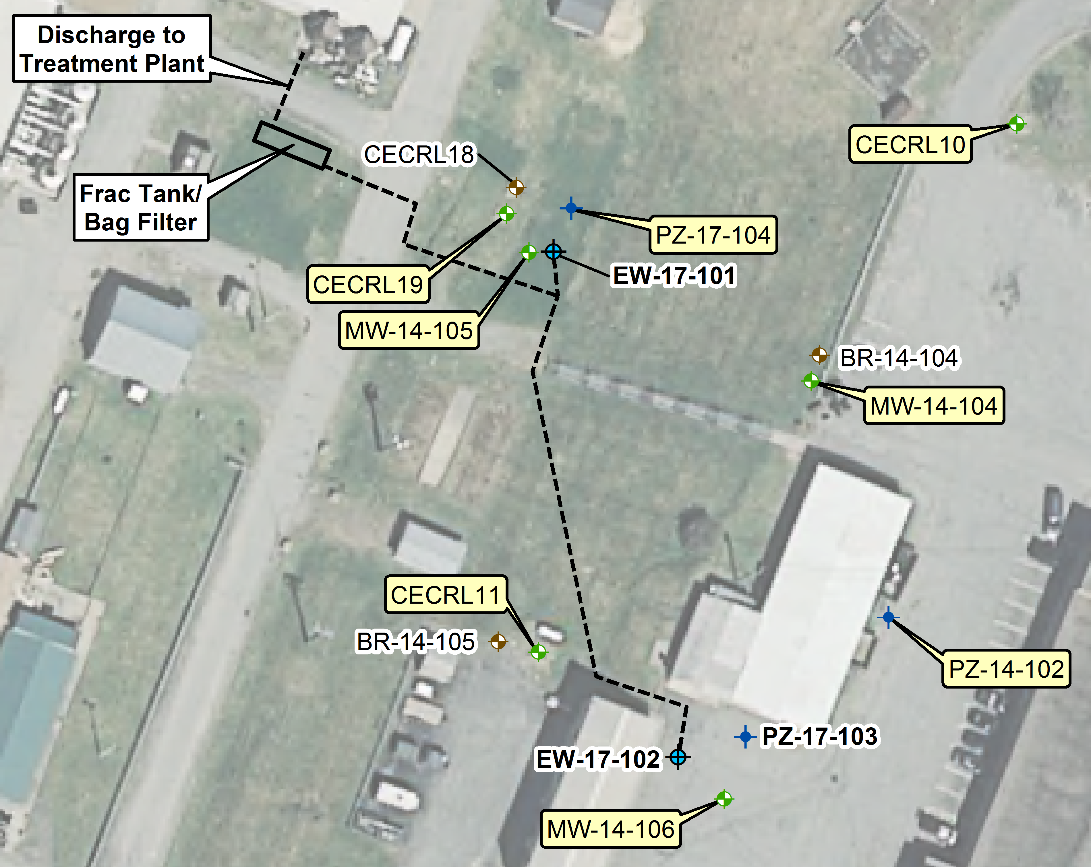
Constant Rate Pumping Test

Slide 6
June 2017 Gas Sampling
Sampling conducted on the Dartmouth Rivercrest Property North of CRREL
Four new sampling points installed
Sampling conducted from June 12th to June 14th, 2017 under stable barometric conditions.
52 soil gas samples analyzed by HAPSITE ®
Soil Vapor Extraction was operating at AOC 2
and AOC 9

Slide 7
Rivercrest Soil Gas Locations

Slide 8
Soil Gas Sampling Results
Concentrations of TCE at Rivercrest dropped up to two orders of magnitude since 2016
Highest concentrations on Rivercrest are near the CRREL property boundary
TCE ranges from 1,200 to 12,000 µg/m³ from 25 to 75 feet below ground surface
SVE Pilots are influencing concentrations off-Site to the north

Slide 9
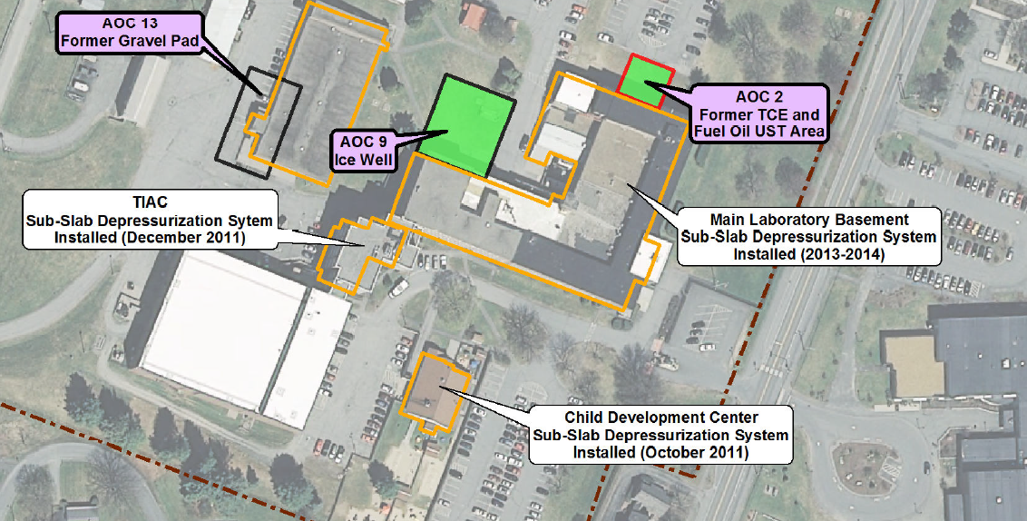
Soil Vapor Extraction Pilot Tests

Slide 10
Soil Vapor Extraction Update
  AOC 2 Operated June 2015-August 2016 and April 2017-Current
  AOC 2 SVE recovered approximately 500 gallons of TCE
  AOC 9 Operated February 2017-August 2017, scheduled to restart in October 2017
  AOC 9 SVE recovered approximately 100 gallons of TCE

Slide 11
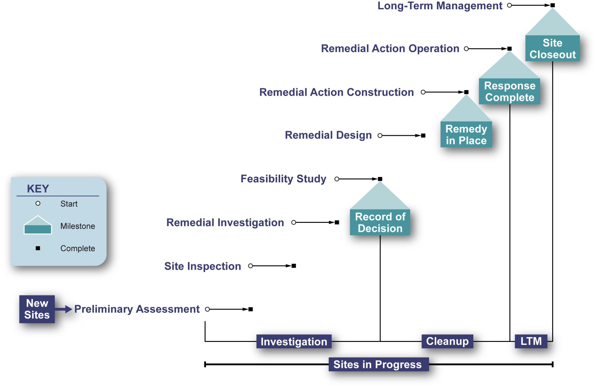
Environmental Restoration Process
Phases and Milestones – Where Are We Now?

Slide 12
RI Conclusions
TCE is the primary contaminant of concern.
Most of the TCE mass is adsorbed to fine grained soils.
Approximately 77K cubic yards of contaminated soil (>0.8 mg/kg).
Approximately 50M gallons of contaminated overburden groundwater (>5 µg/L).
Minimal impact to bedrock groundwater below the facility.
Large soil gas plume (~52 acres) greater than 100 µg/m³.

Slide 13
RI Conclusions (cont.)
Baseline on-post risks do not meet USEPA limits for future:
  Construction worker (vapors in excavation)
  Hypothetical residents (potable use of groundwater, indoor air)
Baseline off-post risks may not meet USEPA limits for hypothetical future:
  Residents at Rivercrest Property (indoor air re: vapor migration and vapor intrusion for future buildings)

Slide 14
What will the Feasibility Study Address?
Exposure to contaminated soil gas by construction workers.
Vapors as a source of groundwater contamination
TCE in overburden groundwater above 5 µg/L
Vapor intrusion into existing and future buildings (deferred)

Slide 15
Deferral of Vapor Intrusion
Baseline indoor air data is not reflective current conditions (Mitigation and Remediation)
Indoor sources have not been quantified and are not effected by environmental cleanup
Additional testing is required without mitigation systems operating.

Slide 16
Effects of Healthmates on Indoor Air

Slide 17
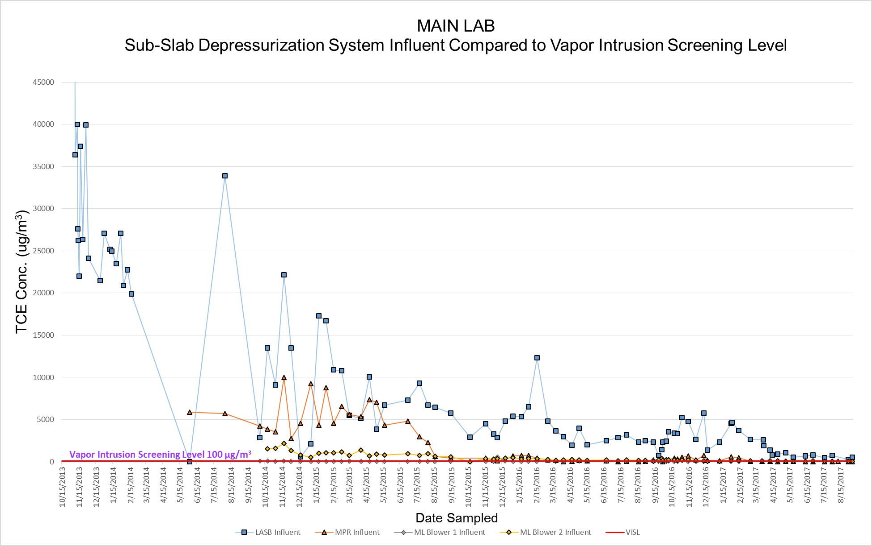

Slide 18
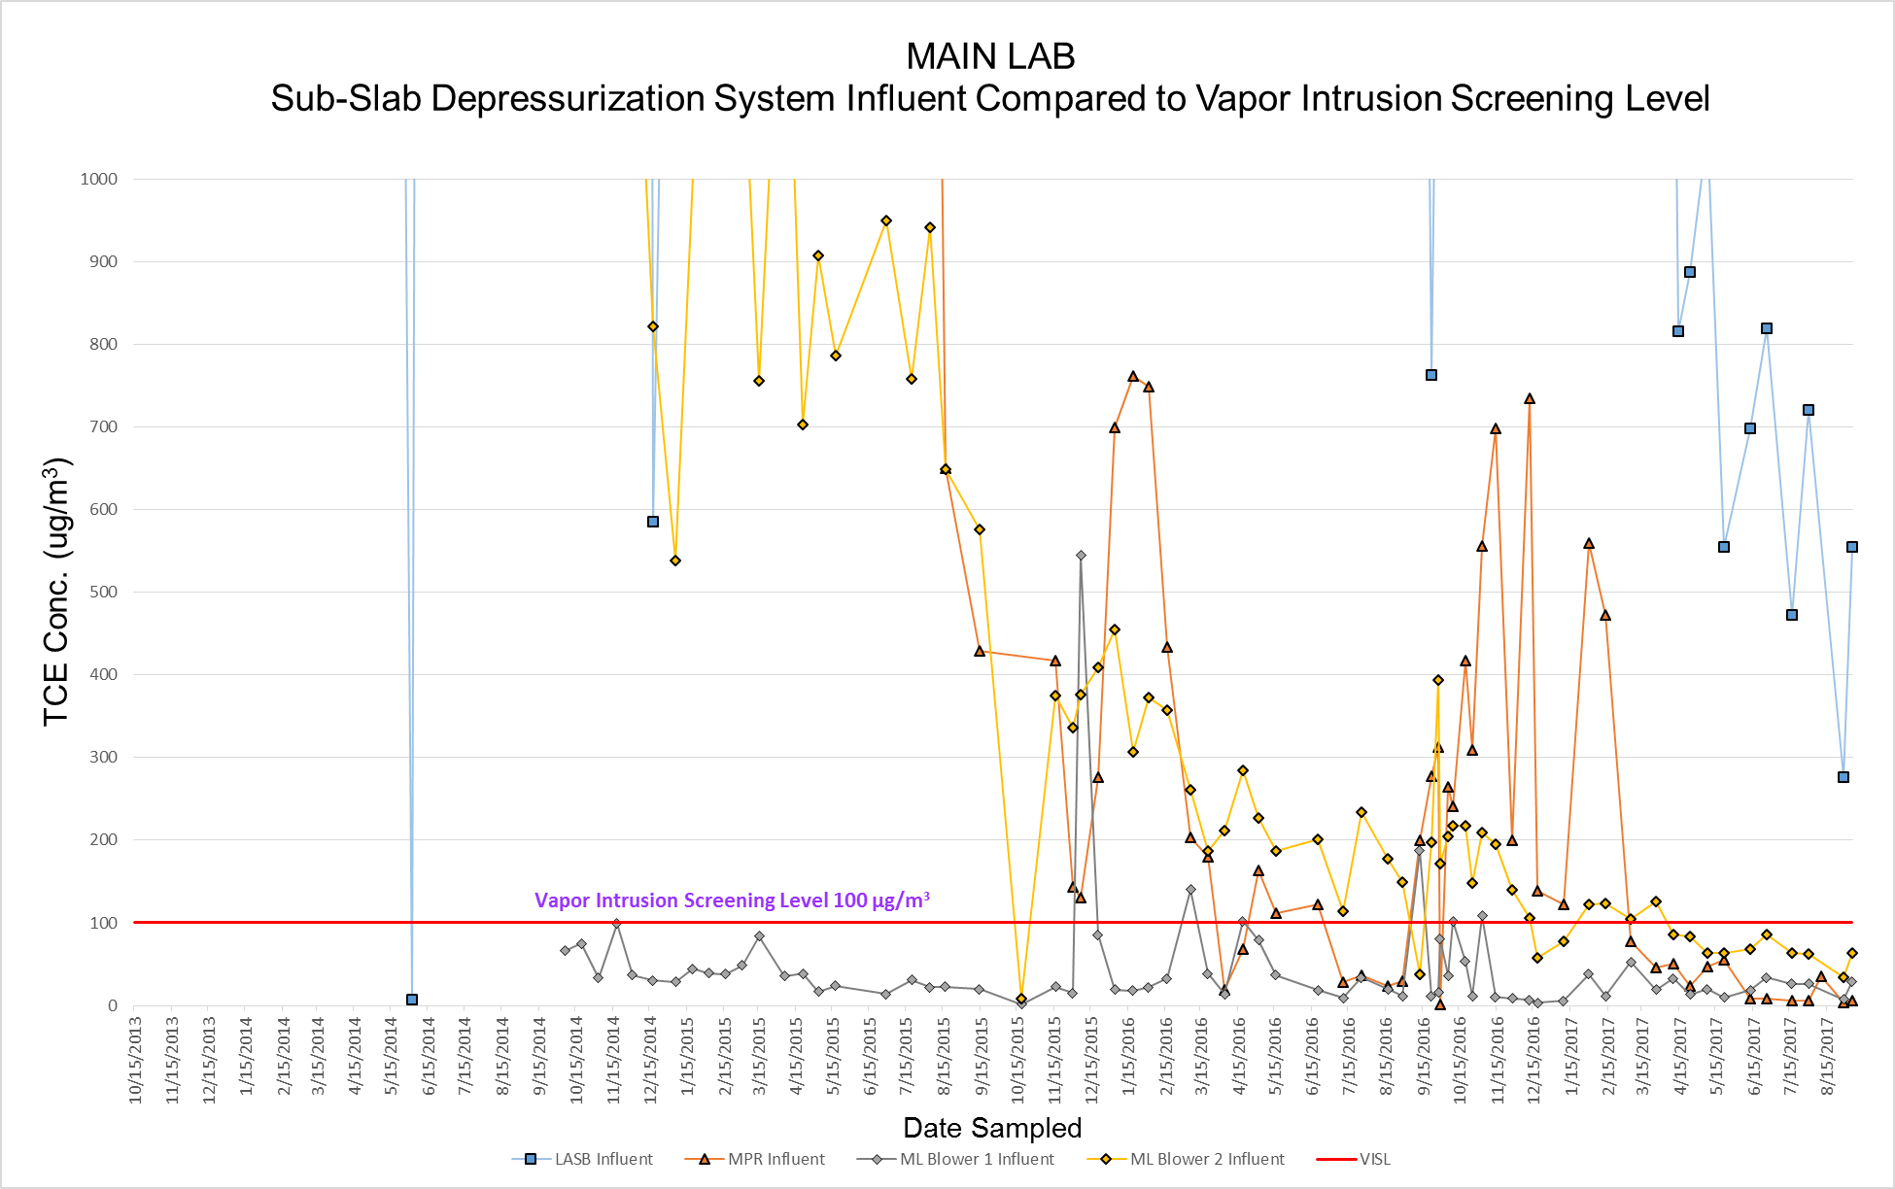

Slide 19
Remedial Alternatives
Range of possible actions
Evaluated based on seven criteria:
  Overall Protectiveness
  Compliance with Applicable or Relevant and Appropriate Requirements
  Long-Term Effectiveness (Permanence)
  Reduction in Toxicity, Mobility, and Volume
  Short-Term Effectiveness (prior to meeting goals)
  Implementability
  Cost

Slide 20
Alternative 1
No Action (Required)

Slide 21
Alternative 2
Continued operation of existing Pump and Treat System
Control of exposure through Institutional Controls
Pump and Treat system operated indefinitely

Slide 22
Alternative 3
Alternative 2
Plus
Soil Vapor Extraction
Likely to treat soil gas plume to construction worker standard
Groundwater risks controlled with Institutional Controls
Indefinite operation of Pump and Treat required

Slide 23
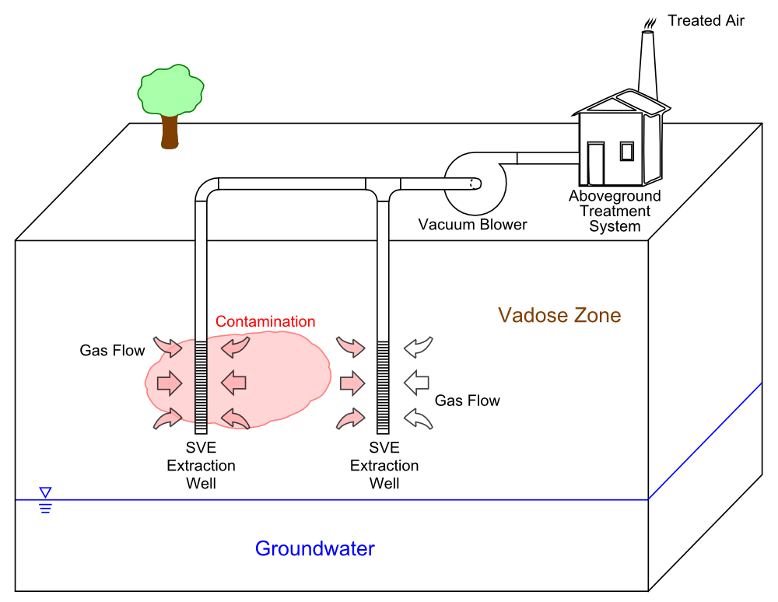

Slide 24
Alternative 4
Alternative 3
Plus
Thermal Treatment of Soil
Treats soil gas plume to construction worker standard
Thermal treatment increases effectiveness of SVE over Alterative 3
Indefinite operation of Pump and Treat required

Slide 25
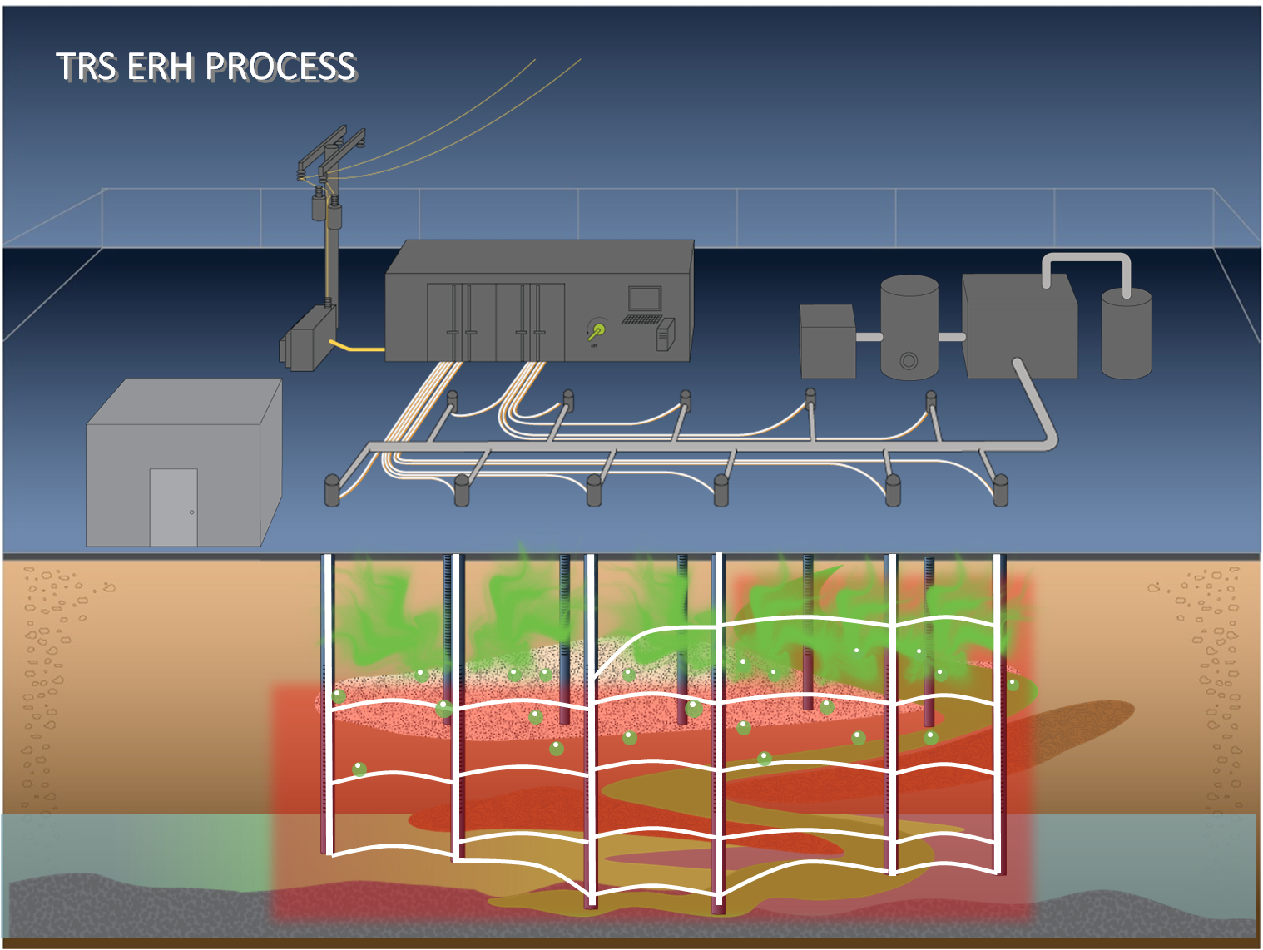

Slide 26
Alternative 5
Thermally Enhance SVE and In-Situ Chemical Oxidation
Treats both soil gas and groundwater plume
Pump and treat system operates until groundwater meets standards (5 µg/L)
Pump and treat system my need modification
Effectiveness in esker uncertain due to groundwater velocity

Slide 27
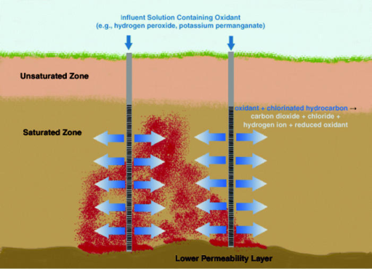

Slide 28
Alternative 6
Thermally Enhanced SVE and Bioremediation (enhanced reductive dechlorination)
Treats both soil gas and groundwater plume
Pump and treat system operates until groundwater meets standards (5 µg/L)
Pump and treat system my need modification
Effectiveness in esker uncertain due to groundwater velocity

Slide 29
Alternative 7
Thermally Enhanced SVE with Air Sparging (Alternative 4 Plus Air Sparging)
Treats both soil gas and groundwater plume
Pump and treat system operated until groundwater meets standards (5µg/L)
Conventional and effective

Slide 30
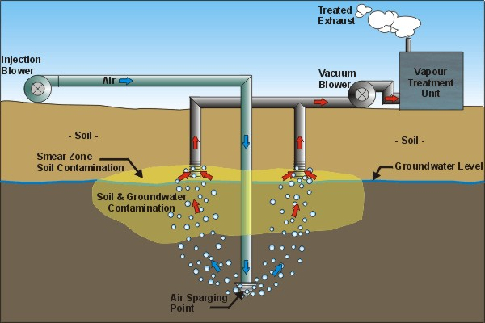

Slide 31
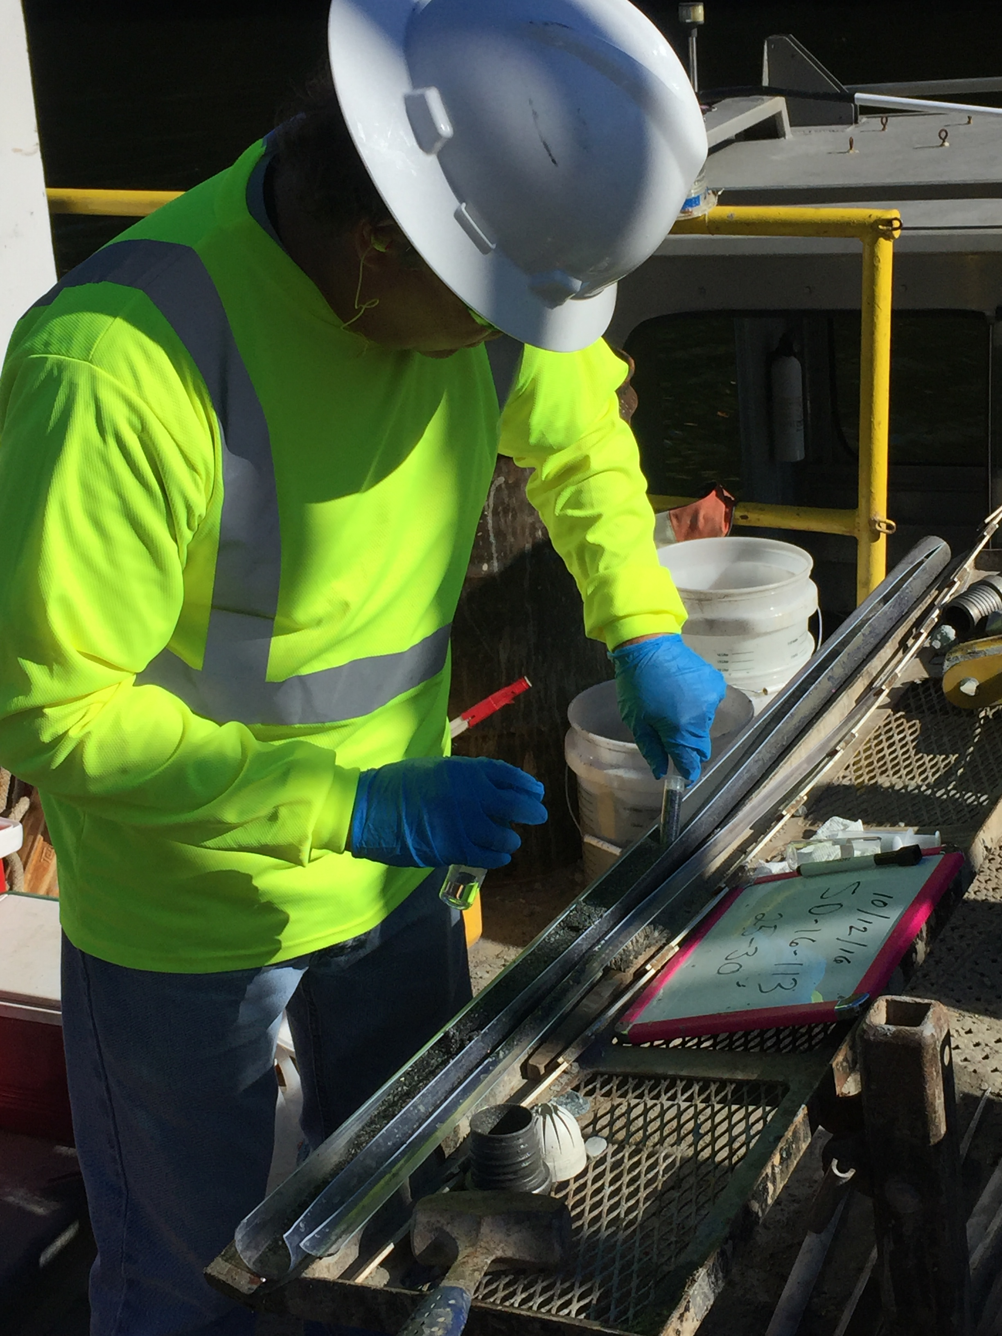
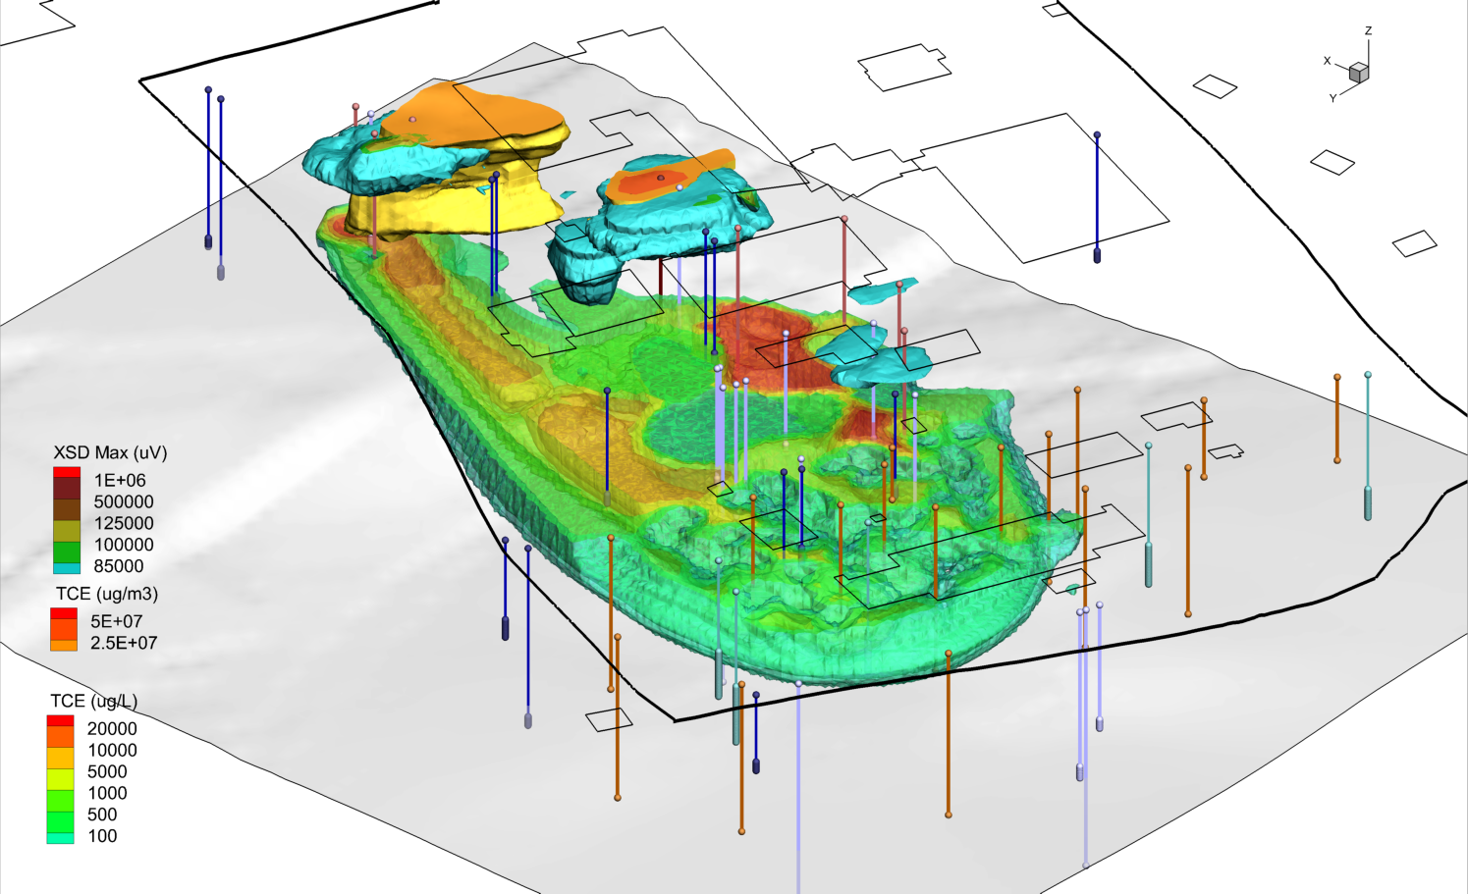
Thank You
Questions or Comments

